Slide 1
Programmable
Logic Devices
Goutham Makkena

Slide 2

PLD
PLD stands for Programmable Logic Device
A PLD is a general-purpose chip for implementing logic circuit. It contains a collection of logic circuit elements that can be customized in different ways
A PLD can be viewed as a “black box” that contains logic gates and programmable switches.
The word “programming” here refers to a hardware procedure which specifies the bits that are inserted into the hardware configuration of the device.
The programmable switches allow the logic gates inside the PLD to be connected together to implement logic circuits

Slide 3
Examples of PLD
ROM is one example of a PLD
Other PLDs are
Programmable logic array (PLA),
Programmable array logic (PAL),
Field‐programmable gate array (FPGA).

Slide 4

Read Only Memory (ROM)
A read‐only memory (ROM) is essentially a memory device in which permanent binary information is stored
The binary information must be specified by the designer and is then embedded in the unit
A block diagram of a ROM consisting of k inputs and n outputs

Slide 5
Read Only Memory (ROM)
The number of words in a ROM is determined from the fact that k address input lines are needed to specify 2^{k} words.
The length of each word is n-bits which is determined from the fact that n output data lines are used
Consider, for example, a 8 X 8 ROM. It unit consists of 8 words of 8 bits each
There are three input lines that form the binary numbers from 0 through 7 for the address.

Slide 6
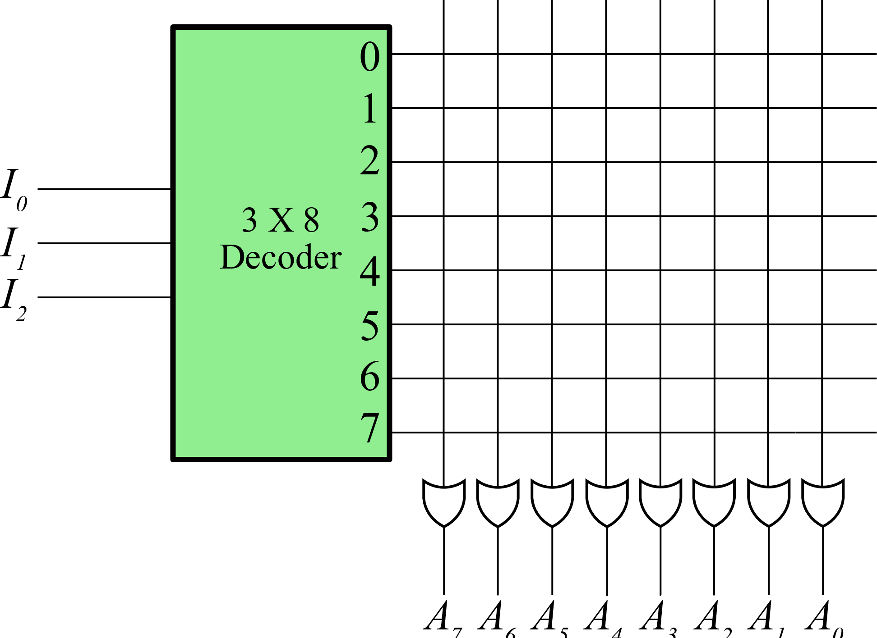
Internal Structure of a ROM
Figure below shows the internal logic construction of 8 X 8 ROM
The three inputs are decoded into 8 distinct outputs by means of a 3 X 8 decoder . Each output of the decoder represents a memory address.
The 8 outputs of the decoder are connected to each of the eight OR gates. Each OR gate must be considered as having 8 inputs
Each output of the decoder is connected to one of the inputs of each OR gate. Since each OR gate has 8 input connections and there are 8 OR gates, the ROM contains 8 * 8 = 64 internal connections
In general, a 2^{k} * n ROM will have an internal k * 2^{k} decoder and n OR gates. Each OR gate has 2^{k} inputs, which are connected to each of the outputs of the decoder

Slide 7
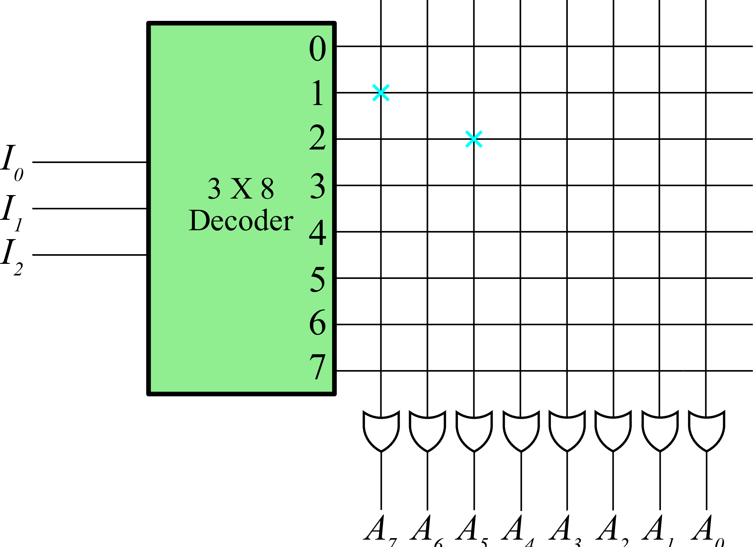
Internal Structure of a ROM
The 64 connections of the ROM are programmable. The programmable intersection between two lines is sometimes called a crosspoint.
One of the simplest technologies employs a fuse that normally connects the two points, but is opened or “blown” by the application of a high‐voltage pulse into the fuse

Slide 8
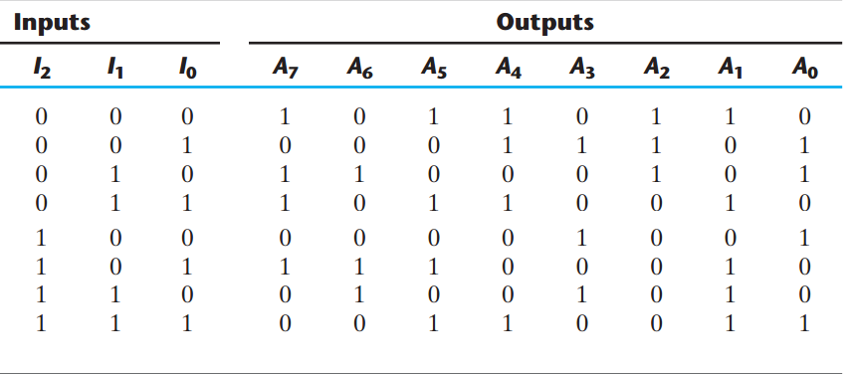
ROM
The internal binary storage of a ROM is specified by a truth table that shows the word content in each address.
For example, the table specifies the eight‐bit word 10110010 for permanent storage at address 3

Slide 9
ROM
The four 0’s in the word are programmed by blowing the fuse links between output 3 of the decoder and the inputs of the OR gates associated with outputs A6, A3, A2, and A0.
The four 1’s in the word are marked with a X to denote a temporary connection

Slide 10
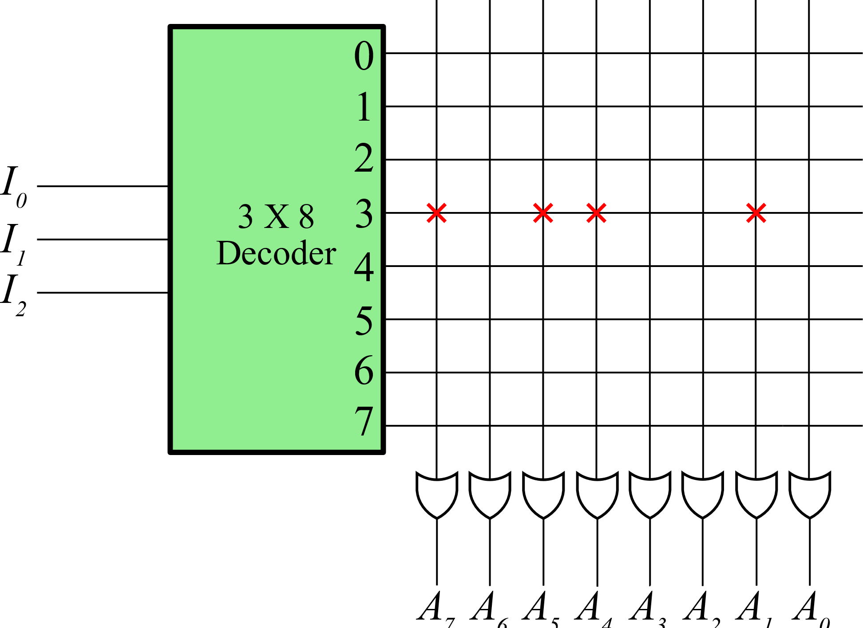
ROM
Other locations can be similarly programmed from the truth table
Address 3 programmed with eight‐bit word 10110010 for permanent storage

Slide 11
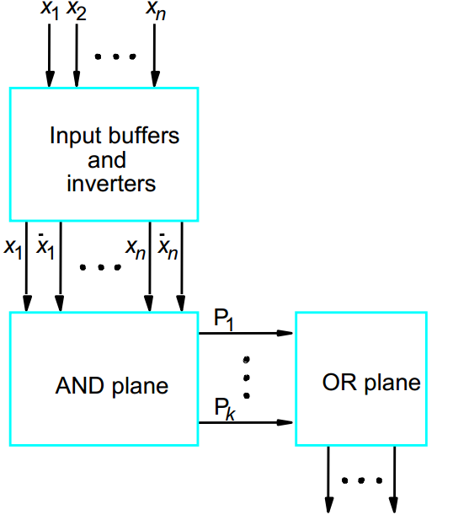
PLA (Programmable Logic Array)
PLA is developed based on the sum-of-product form
PLA includes a circuit block called AND array (AND plane) and another circuit block called OR array (OR plane)

Slide 12
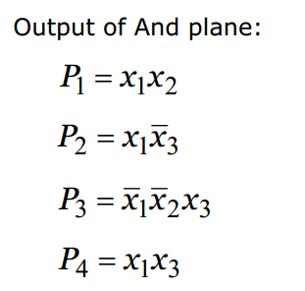
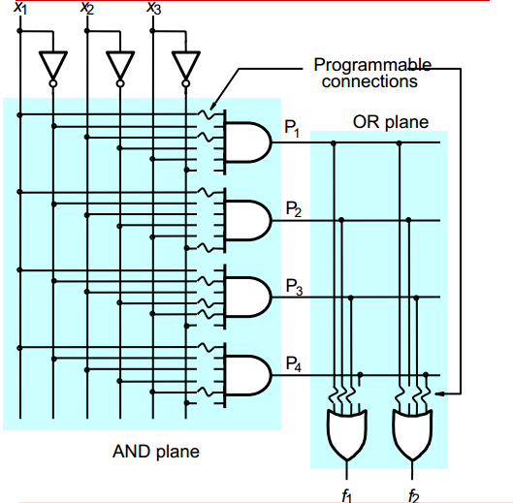
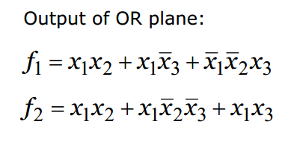
PLA (Gate Level diagram)

Slide 13
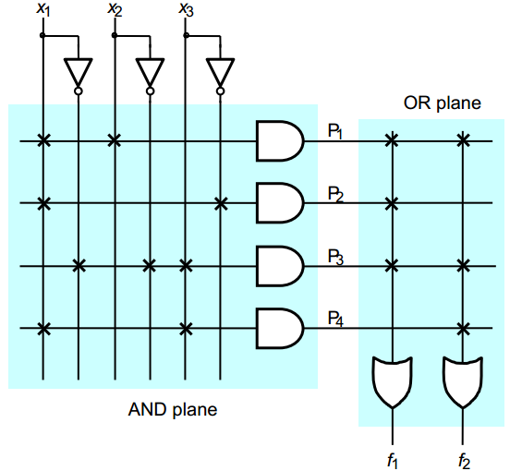
PLA (schematic)

Slide 14
PAL (Programmable Array Logic)
PAL is similar to PLA
Difference between PLA and PAL PLA: Both AND plane and OR plane are programmable. PAL: Only AND plane is programmable, while OR plane is fixed

Slide 15
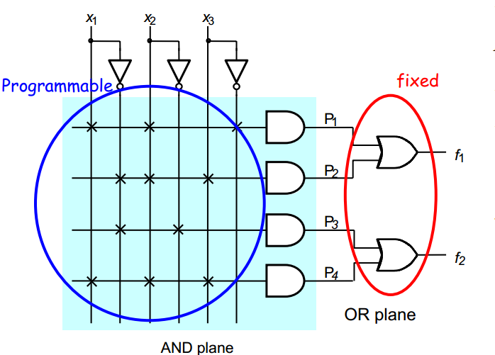
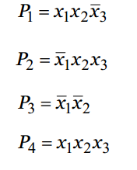
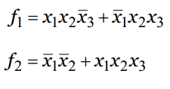
PAL (Programmable Array Logic)
The circuit shown is a 2-wide PAL as it uses two input OR gates

Slide 16
Comparison between PAL and PLA
Comparison between PLA and PAL Drawbacks of PLA - PLA hard to be implemented (both planes need to be programmable) - PLA reduces the speed performance of circuits. Advantages of PAL Simple to manufacture
Less expensive Better performance Disadvantage of PAL Not flexible as compared PLA, because OR plane is fixed.

Slide 17
Complex Programmable Logic Devices (CPLDs)
A CPLD comprises multiple circuit blocks on a single chip, with internal wiring resources to connect the circuit blocks
Each circuit block is similar to a PLA or a PAL
We will refer to the circuit blocks as PAL-like blocks

Slide 18
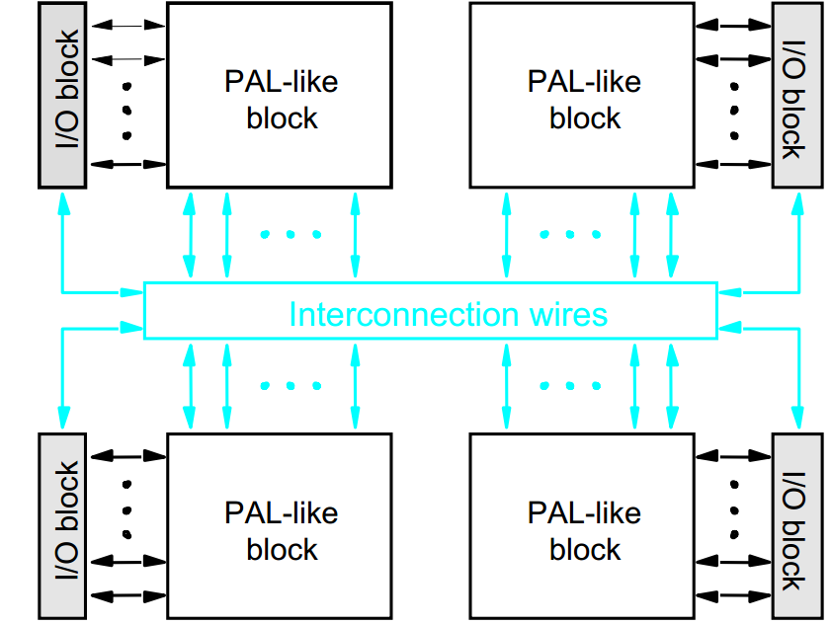
Complex Programmable Logic Devices (CPLDs)

Slide 19
FPGA (Field Programmable Gate Arrays)
FPGA is a programmable logic device that supports implementation of relatively large logic circuits
Unlike CPLD, FPGAs do not contain AND or OR planes
Instead, FPGAs provide logic blocks and interconnection wires and switches

Slide 20
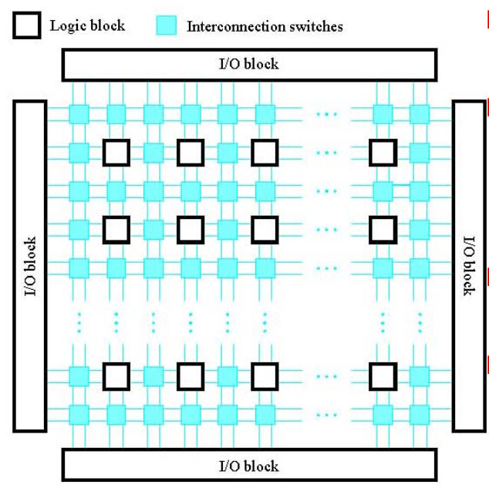
FPGA (Field Programmable Gate Arrays)
The logic blocks are arranged in a two-dimensional array, depicted as hollow black box
The interconnection wires, depicted as solid blue box, are organized as horizontal and vertical routing channels between rows and columns of logic blocks
Programmable connections also exist between I/O blocks and the interconnection wires
FPGA can implement circuit of more than a million equivalent gates in size
Lookup table (LUT) is the most commonly used logic block in FPGA

Slide 21
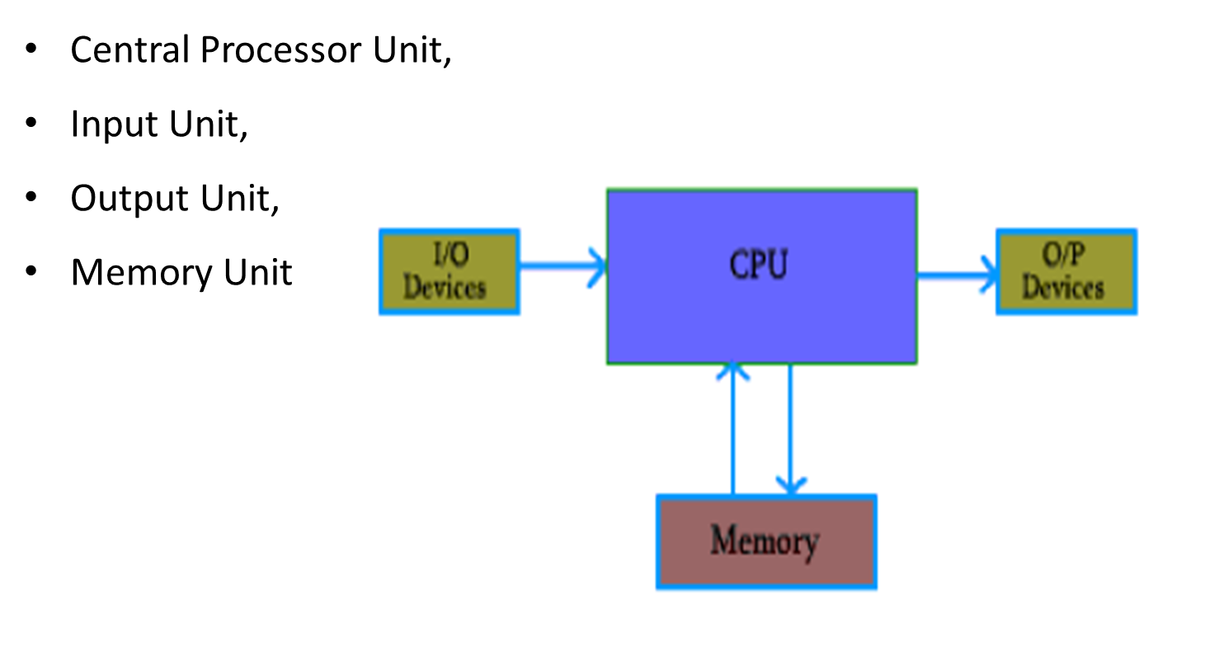
Basic Computer Model and different units of Computer

Slide 22
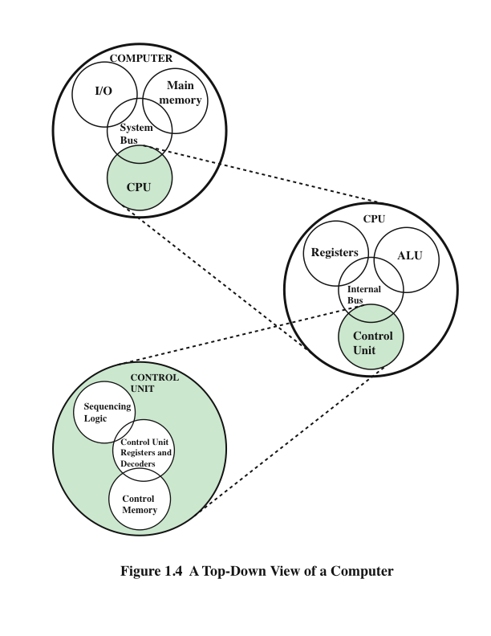
Components of Computer
CPU – controls the operation of the computer and performs its data processing functions.
Main Memory – stores data.
I/O – moves data between the computer and its external environment.
System Interconnection – some mechanism that provides for communication among CPU, main memory, and I/O

Slide 23
ALU-Arithmetic & Logical Unit
An arithmetic logic unit (ALU) is a combinational digital electronic circuit that performs arithmetic and bitwise operations on integer binary numbers.
An ALU is a fundamental building block of many types of computing circuits, including the central processing unit (CPU) of computers, Floating Point Unit (FPUs), and graphics processing units (GPUs).

Slide 24
ALU-Arithmetic & Logical Unit
Two important parameters in ALU are:
Operand length
Number of operations
The operand length is the no.of bits in each operand.
Suppose if we want to achieve bit wise AND operation of A = 1011 and B=0111.
Here A and B are operands and have 4 bits each
The number of operations depends on our requirement.
Suppose we want to perform 4 logical operations as follows
AND
OR
NAND
NOR

Slide 25
ALU-Arithmetic & Logical Unit
Now, the operand length is 4 and number of operations is also 4.
In order to select one operation from 4 different operations, we require a 4:1 mux
Because we have 4 bits in each operand, we need 4 such 4:1 multiplexers
AND 00
OR 01
NAND 10
NOR 11

Slide 26
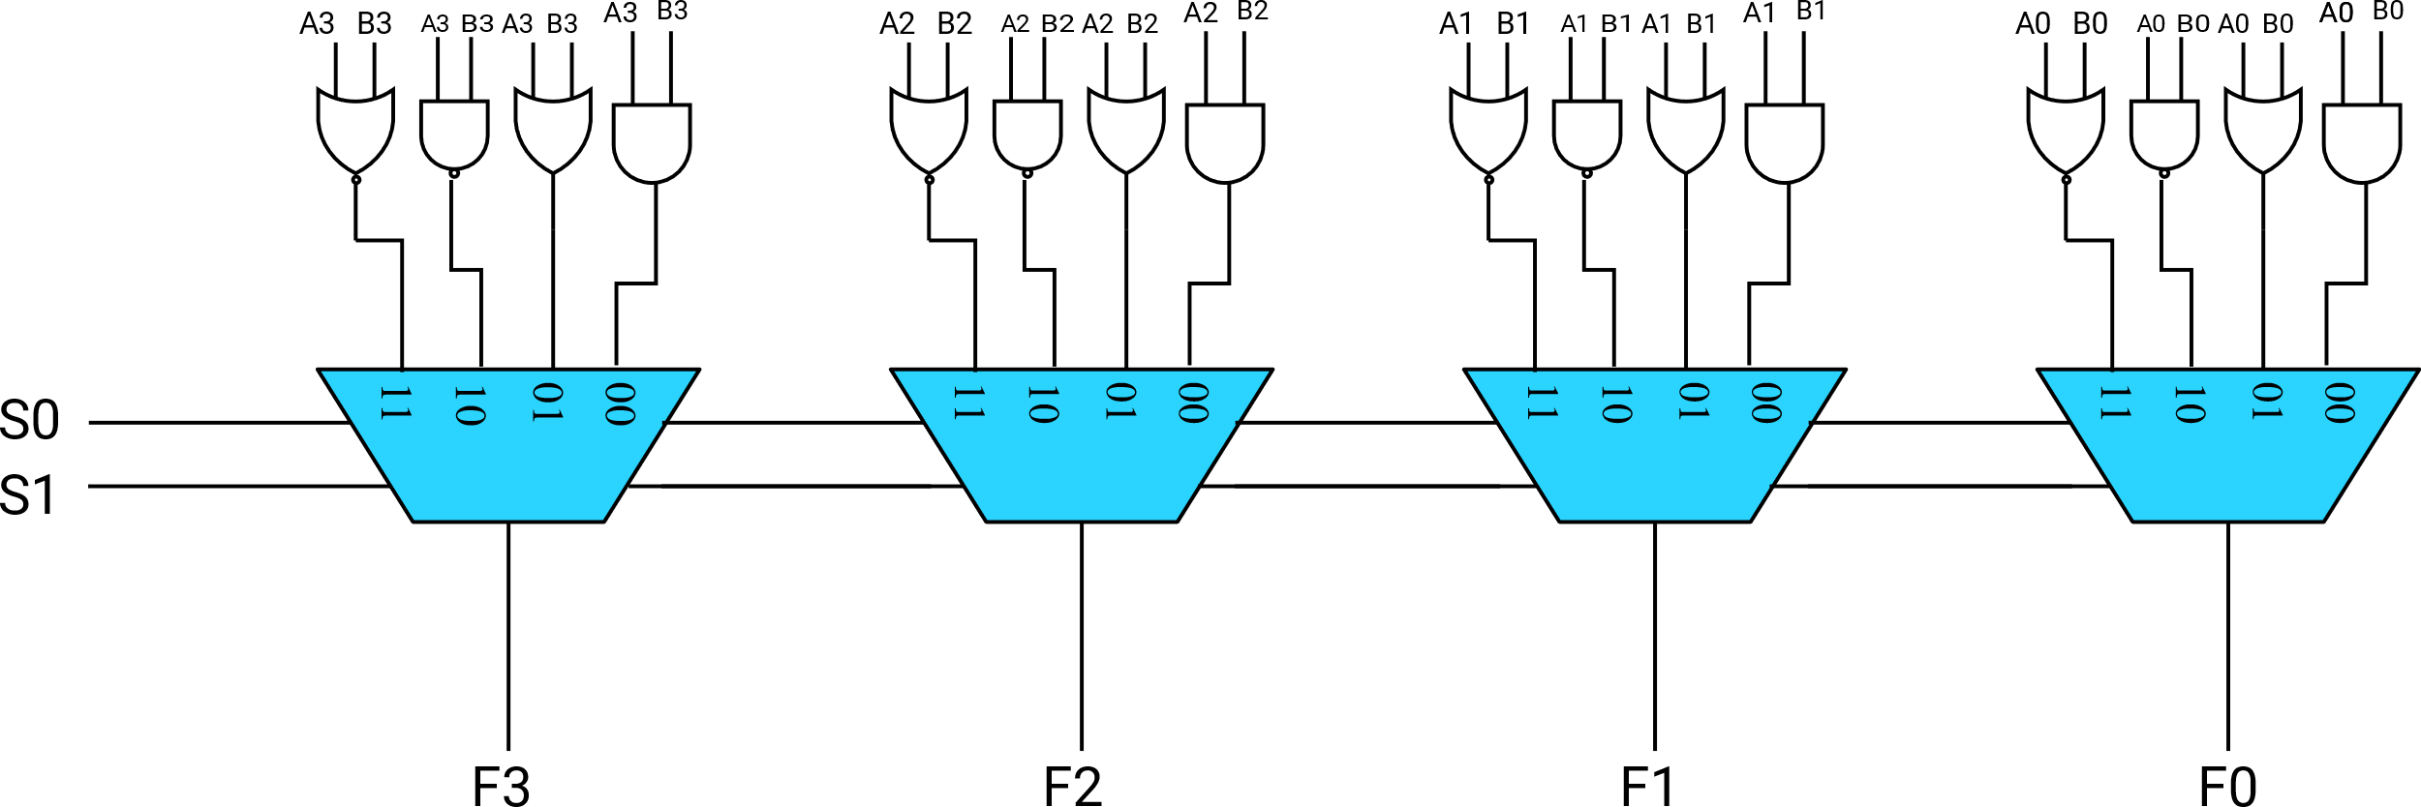
ALU-Arithmetic & Logical Unit

Slide 27
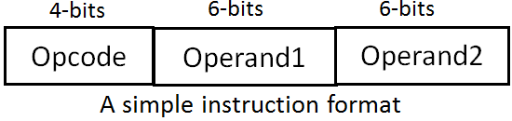
Instructions
The operation of a CPU is determined by the instruction it executes, referred to as machine instructions or computer instructions. The collection of different instructions is referred as the instruction set of the CPU.
Each instruction must contain the information required by the CPU for execution.
Opcodes are represented by abbreviations, called mnemonics, that indicate the operations
A simple instruction has opcodes and operands as shown

Slide 28
Instructions
A simple instruction has opcodes and operands as shown below
Example: ADD A, B
SUB C,D

Slide 29


